Slide 1

Data Structures Topic: Stacks
By
Ravi Kant Sahu
Asst. Professor
Lovely Professional University, Punjab

Slide 2
Outlines
Introduction
Basic Operations
Array Representation of Stacks
Linked Representation of Stacks
Minimizing Overflow
Review Questions

Slide 3
Introduction
Stacks:
A stack is a list of elements in which an element may be inserted or deleted only at one end, called the “TOP” of the Stack.
Stack is a LIFO (Last In First Out) data structure.
Elements are removed from a stack in the reverse order of that in which they were inserted into the stack.

Slide 4
Examples
Stack of Dishes
Stack of Books
A packet of Biscuits etc.
Note: AVAIL List is also implemented using STACK.

Slide 5
Basic Operations
Push: Process of inserting an element into Stack.
Pop: Process of deleting the top most element from stack.

Slide 6
STACK
PUSH
Anuj
TOP = 1
TOP = 0

Slide 7
Array Representation of Stacks
STACK
Ravi | Arvind | Deepak | Neha
1
2
3
4
5
6
7
8
4
8
TOP
MAXSTK

Slide 8
Array Representation of Stacks
PUSH (STACK, TOP, MAXSTK, ITEM)
[Stack already filled?] If TOP = MAXSTK, then: Print: OVERFLOW and Return.
Set TOP = TOP +1. [Increase TOP by 1.]
Set STACK [TOP] = ITEM. [Insert ITEM into the TOP.]
Return

Slide 9
Array Representation of Stacks
POP (STACK, TOP, ITEM)
[Stack has an ITEM to be removed?] If TOP = 0, then: Print: UNDERFLOW and Return.
Set ITEM = STACK [TOP]. [ITEM is the TOP element.]
Set TOP = TOP - 1. [Decrease TOP. by 1.]
Return

Slide 10
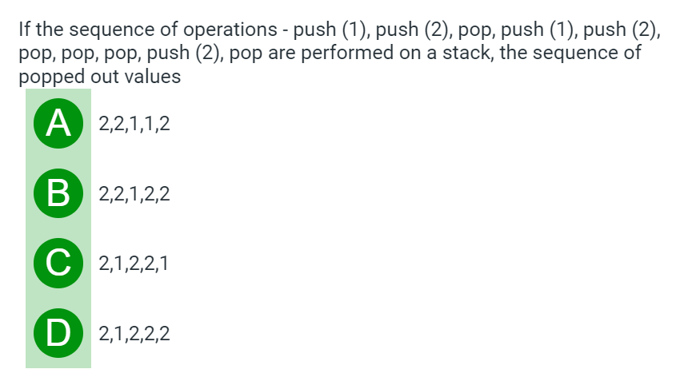
Brainstorming

Slide 11
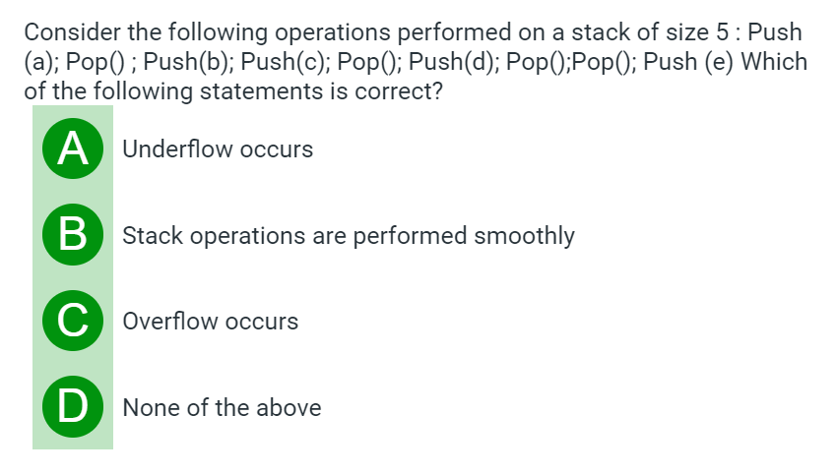
Brainstorming

Slide 12
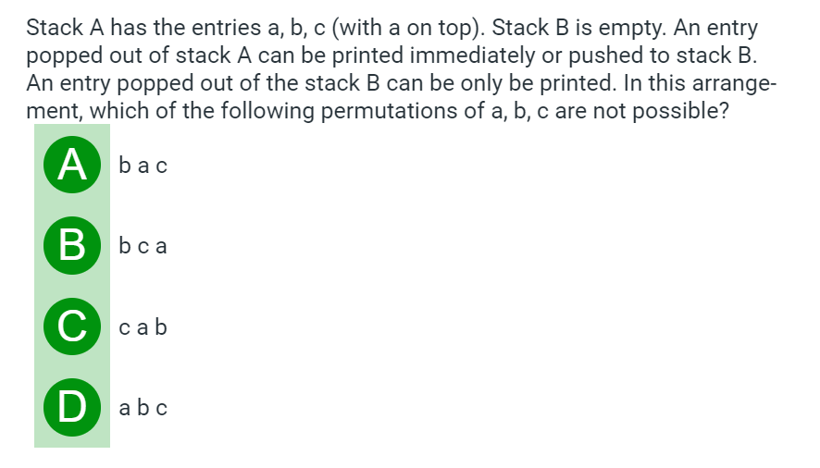
Brainstorming

Slide 13
Linked Representation of Stacks
PUSH_LINKSTACK (INFO, LINK, TOP, AVAIL, ITEM)
[Overflow?] If AVAIL = NULL, then: Print: OVERFLOW and Exit.
Set NEW = AVAIL and AVAIL = LINK [AVAIL]. [Remove first node from AVAIL List.]
Set INFO [NEW] = ITEM.
Set LINK [NEW] = TOP. [NEW node points to the original top node in the stack.]
Set TOP = NEW. [Reset TOP to point to new node .]
Exit.

Slide 14
Linked Representation of Stacks
POP_LINKSTACK (INFO, LINK, TOP, AVAIL, ITEM)
[Underflow?] If TOP = NULL, then: Print: UNDERFLOW and Exit.
Set ITEM = INFO [TOP]. [Copy the top element into Item.]
Set TEMP = TOP and TOP = LINK [TOP]. [Remember the old value of TOP and Reset TOP.]
Set LINK [TEMP] = AVAIL and AVAIL = TEMP. [Return deleted node to AVAIL List.]
Exit.

Slide 15
Minimizing Overflow
Stack involves a Time-space Trade-off.
By reserving a great deal of space for stack, we can minimize number of overflows.

Slide 16
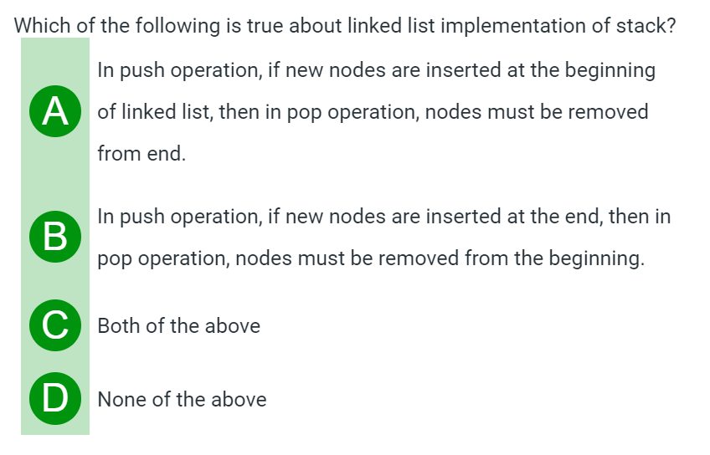
Brainstorming

Slide 17
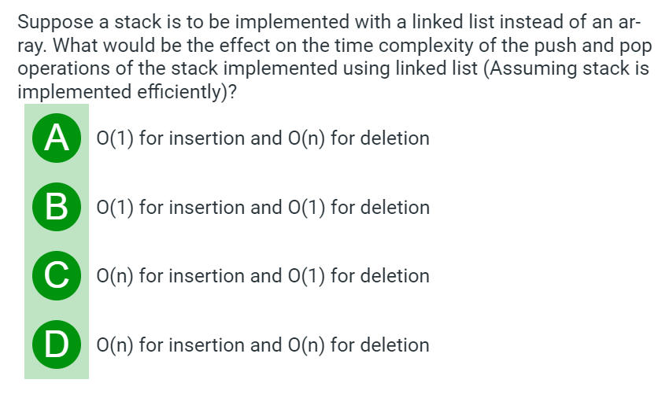
Brainstorming

Slide 18
Arithmetic Expressions
Arithmetic Expressions involve constants and operations.
Binary operations have different levels of precedence.
First : Exponentiation (^)
Second: Multiplication (*) and Division (/)
Third : Addition (+) and Subtraction (-)

Slide 19
Example
Evaluate the following Arithmetic Expression:
5 ^ 2 + 3 * 5 – 6 * 2 / 3 + 24 / 3 + 3
First:
25 + 3 * 5 – 6 * 2 / 3 + 24 / 3 + 3
Second:
25 + 15 – 4 + 8 + 3
Third:
47

Slide 20
Polish Notation
Infix Notation: Operator symbol is placed between the two operands.
Example:
(5 * 3) + 2 & 5 * (3 + 2)

Slide 21
Polish Notation
Polish Notation: The Operator Symbol is placed before its two operands.
Example: + A B, * C D, / P Q etc.
Named after the Polish Mathematician Jan Lukasiewicz.
The order in which the operations are to be performed is completely determined by the positions of operators and operands in the expression.

Slide 22
Examples
(A + B) * C = * + ABC
A + (B * C) = + A *BC
(A + B) / (C - D) = / +AB –CD
Also Known as Prefix Notation.

Slide 23
Reverse Polish Notation
Reverse Polish Notation: The Operator Symbol is placed after its two operands.
Example: A B+, C D*, P Q/ etc.
Also known as Postfix Notation.

Slide 24
Evaluation of Postfix Expression
P is an arithmetic expression in Postfix Notation.
Add a right parenthesis “)” at the end of P.
Scan P from left to right and Repeat Step 3 and 4 for each element of P until the sentinel “)” is encountered.
If an operand is encountered, put it on STACK.
If an operator @ is encountered, then: (A) Remove the two top elements of STACK, where A is the top element and B is the next to top element. (B) Evaluate B @ A. (C) Place the result of (B) back on STACK. [End of if structure.] [End of step 2 Loop.]
Set VALUE equal to the top element on STACK.
Exit.

Slide 25
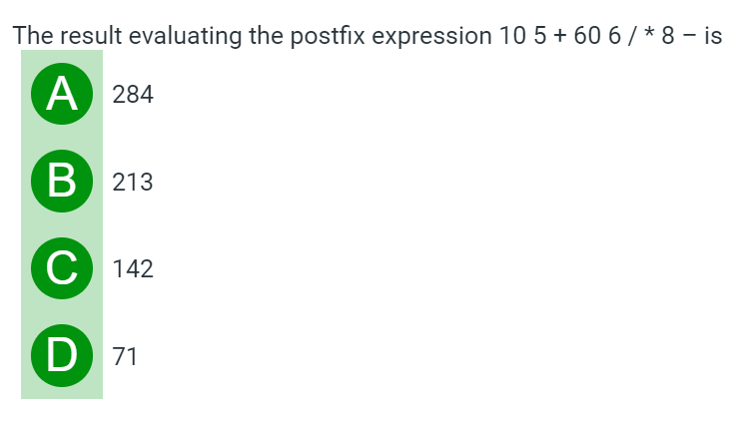
Brainstorming

Slide 26
Review Questions
Evaluate the following Post-fix Expression:
12 7 3 - / 2 1 5 + * +

Slide 27
Infix to Postfix Transformation
POLISH (Q, P)
PUSH “(” on to STACK and add “)” to the end of Q.
Scan Q from left to right and Repeat steps 3 to 6 for each element of Q until the STACK is empty:
If an operand is encountered, add it to P.
If a left parenthesis is encountered, push it onto STACK.
If an operator is encountered, then: (a) Repeatedly POP from STACK and add to P each operator (On the TOP of STACK) which has the same precedence as or higher precedence than @. (b) Add @ to STACK. [End of If structure.]
If a right parenthesis is encountered, then: (a) Repeatedly POP from STACK and add to P each operator (On the TOP of STACK.) until a left parenthesis is encountered. (b) Remove the left parenthesis. [Don’t add the left parenthesis to P.] [End of If Structure.]
[End of step 2 Loop.]
7. Exit.

Slide 28
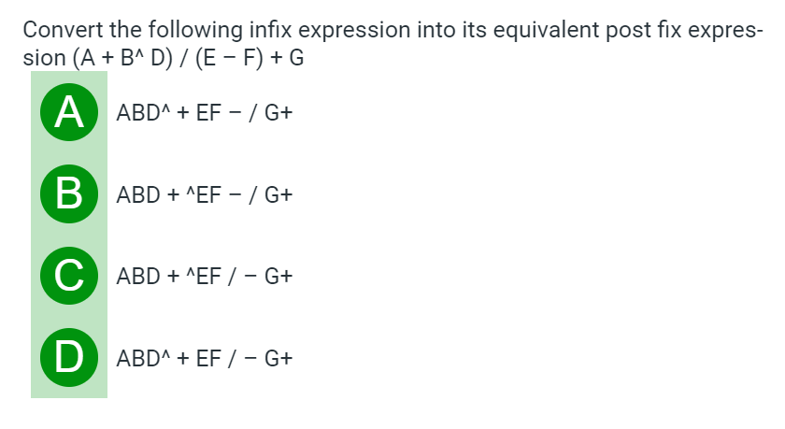
Brainstorming

Slide 29
Applications of STACK

Slide 30
Quick Sort
QUICK_SORT (A, p, r)
1. if p < r
then: q ← PARTITION ( A, p, r)
QUICK_SORT (A, p, q-1)
QUICK_SORT (A, q+1, r)

Slide 31
PARTITION (A, p, r)
Set x ← A[r].
Set i ← p-1.
Repeat Step 4 to 6 for j ← p to r-1
do if A[j] <= x.
then i = i+1.
Exchange A[i] ←→ A[j]
Exchange A[i+1] ←→ A[r]
return i+1.

Slide 32
Quick Sort
Example
Example 2
Tower of Hanoi Problem Solving
https://www.mathsisfun.com/games/towerofhanoi.html

Slide 33
Towers of Hanoi
TOWER (N, BEG, AUX, END)
If N = 1, Then: (a) Write: BEG → END. (b) Return. [End of If Structure.]
Call TOWER (N-1, BEG, END, AUX). [Move N-1 disks from peg BEG to peg AUX.]
Write BEG → END.
Call TOWER (N-1, AUX, BEG, END). [Move N-1 disks from peg AUX to peg END.]
Return.

Slide 34
Review Questions
What is the need of Stacks?
How Array representation of Stack is different from Linked Representation?
How will you handle Overflow and Underflow?

Slide 35
Review Questions
Convert the following infix expression to Post-fix:
12 / (7-3) + 2 * (1+5)
(5^3) / (3+9) – (5*0) + 2

Slide 36


